Slide 1
Machine Learning

Slide 2
Program Introduction

Slide 3
About Simplilearn

Slide 4

Simplilearn
Simplilearn has focused on its digital economy skills for over a decade. It is now the world's most popular online bootcamp.

Slide 5




Simplilearn
Simplilearn provides:
Live virtual classes (LVCs)
Self-paced
learning content
Interactive labs
Real-time,
scenario-based projects

Slide 6
Introduction to Machine Learning

Slide 7

What Is Applied Machine Learning?
The implementation of machine learning to a particular data-related problem is known as machine learning.
It uses techniques and theories from mathematics, statistics, computer science, domain knowledge, and information science to build the model.
Machine learning can be used to solve any problem with probabilistic elements, but it is particularly helpful for manipulating and interpreting large amounts of statistically produced data.

Slide 8
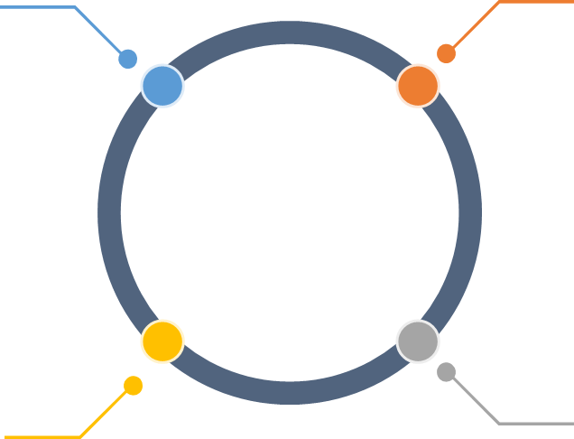
Benefits of Machine Learning
Various uses:
Its usage can be seen in a variety of fields, including healthcare, banking, as well as science and technology.
Automation:
It means providing machines with the ability to learn, allowing them to make decisions and self-improve algorithms.
Handles different types of data:
It is capable of managing and processing any form of data that normal systems can’t.
Handles data:
It allows users to handle a large amount of data.

Slide 9
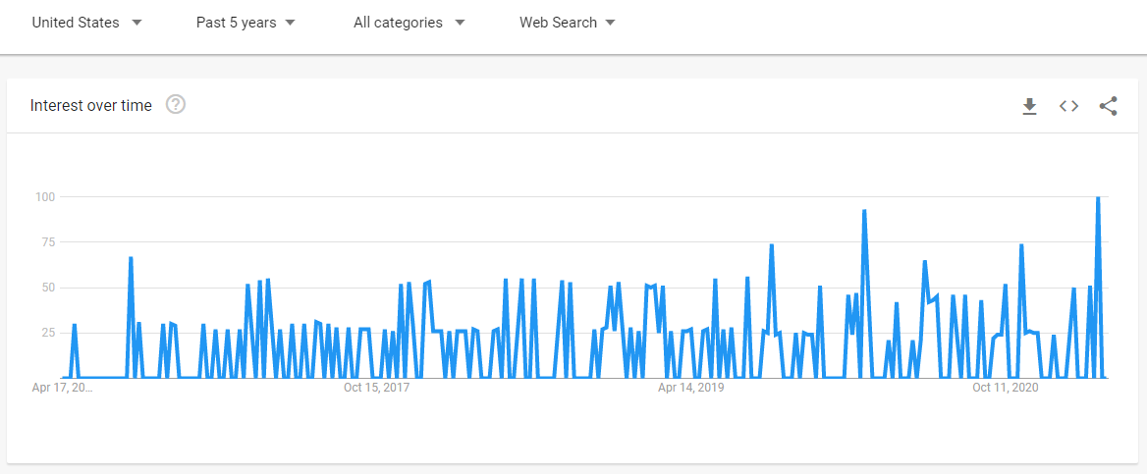
Demand for Machine Learning
The demand for machine learning is rapidly increasing. Machine learning is expected to continue to grow significantly in the future.
Search trend for applied machine learning in the last five years
Source: https://trends.google.com/trends/?geo=US

Slide 10









Companies Hiring Applied Machine Learning Engineers
There are many companies around the world that hire applied machine learning engineers.
These include:

Slide 11
Simplilearn Program Features

Slide 12
Program Features
The blended learning program is a combination of:
Self-paced learning content
Live virtual classes (LVCs)
Hands-on exercises

Slide 13




Program Features
The program contains different features listed below:
Theoretical concepts
Case studies
Integrated labs
Projects

Slide 14

Program Features
Class sizes are limited to foster maximum interaction.

Slide 15
Learning Path

Slide 16

Target Audience
Anyone who aspires to be a data scientist must have an understanding of programming in any one of the popular languages. The target audience includes:
Programmers
Software developers
Analysts
Learning enthusiasts

Slide 17








Applied Machine Learning Expert
For instance, if an associate programmer who recently graduated as an engineer decides to become an applied machine learning expert, they can do so after completing this program.
Associate Programmer
Applied Machine Learning Expert

Slide 18
Course Outline
1
3
Introduction to Machine Learning
Decision Trees and Random Forest
Course Introduction
Supervised Learning: Regression and Classification
2
4

Slide 19
Course Outline
5
7
Time Series Modeling
Recommender Systems
Unsupervised Learning
Ensemble Learning
6
8

Slide 20

Learning Path: Lesson 1
Instructor-Led Classes
Self-Paced Learning Content
Course Introduction
Lessons and components
Program features and course outline
Walk through of Jupyter lab demo

Slide 21

Learning Path: Lesson 2
Instructor-Led Classes
Self-Paced Learning Content
Introduction to Machine Learning
Emergence of artificial intelligence
Relationship between AI, ML, and data science
Machine learning approach

Slide 22

Learning Path: Lesson 3
Instructor-Led Classes
Self-Paced Learning Content
Supervised Learning: Regression and Classification
Supervised learning: process flow
Types of regression algorithms
Understanding the Maximum Likelihood Estimation
Naive Baye’s theorem
Model evaluating using accuracy score and confusion matrix

Slide 23

Learning Path: Lesson 4
Instructor-Led Classes
Self-Paced Learning Content
Decision Trees and Random Forest
Decision tree
Overfitting and pruning
Random forest
Bagging and bootstrapping

Slide 24

Learning Path: Lesson 5
Instructor-Led Classes
Self-Paced Learning Content
Unsupervised Learning
Unsupervised learning - process flow
Clustering
K-means clustering
Elbow method
Hierarchical clustering

Slide 25
Learning Path: Lesson 6
EDA
Instructor-Led Classes
Self-Paced Learning Content
Time Series Modeling
What is time series?
Time plot
Important terms related to time series data
Stationarity check

Slide 26

Learning Path: Lesson 7
Instructor-Led Classes
Self-Paced Learning Content
Ensemble Learning
What is ensemble learning?
Working of ensemble learning
Ensemble learning methods
Types of ensemble methods

Slide 27
Learning Path: Lesson 8
Instructor-Led Classes
Self-Paced Learning Content
Recommender Systems
What is a recommender system?
Popularity based recommender system
Building an end-to-end recommender system
Using the surprise module

Slide 28
Program Components

Slide 29
Program Components
E-books: All lessons are available as PDF files to download and use as quick reference guides
Assisted practices: To assist you in developing abilities that will make you an asset to any business
Assessments: There are over 100 questions to assess your knowledge
Projects: Lesson-end projects and course-end projects to develop your machine learning skills by solving real-life, industry-based projects

Slide 30
Let’s Get Started

